Slide 1


Open access journals
Pensoft Journal Ststem
PJS 2.0
Lyubomir Penev
Bulgarian Academy of Sciences & Pensoft Publishers
ViBRANT Tools for DNA taxonomists,
11 June 2013, Brussels
ViBRANT

Slide 2

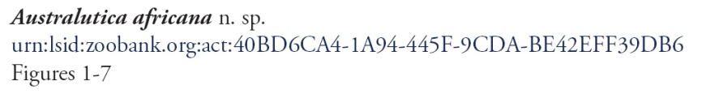

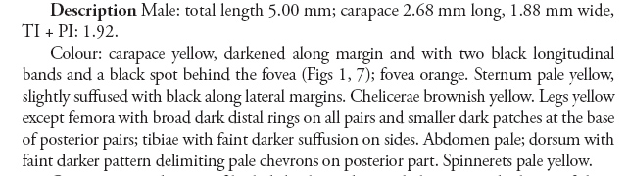



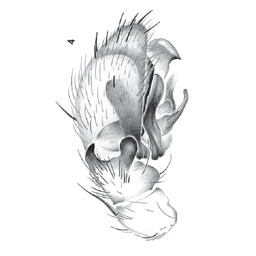
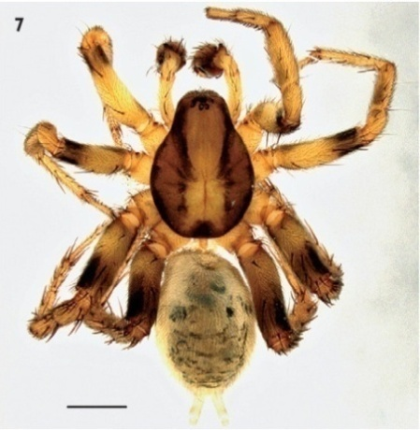

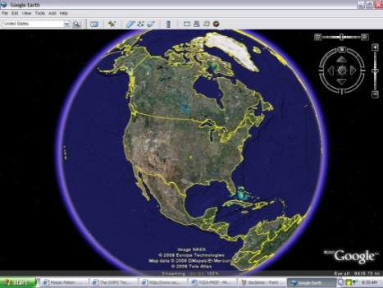

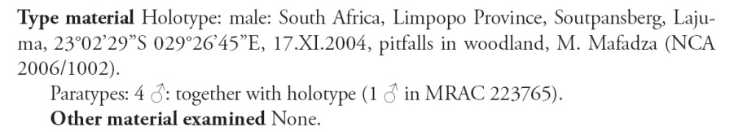
Advanced open access publishing – what does it mean?
Nomenclature
Literature
Descriptions
Plazi
Images
Occurrences

Slide 3
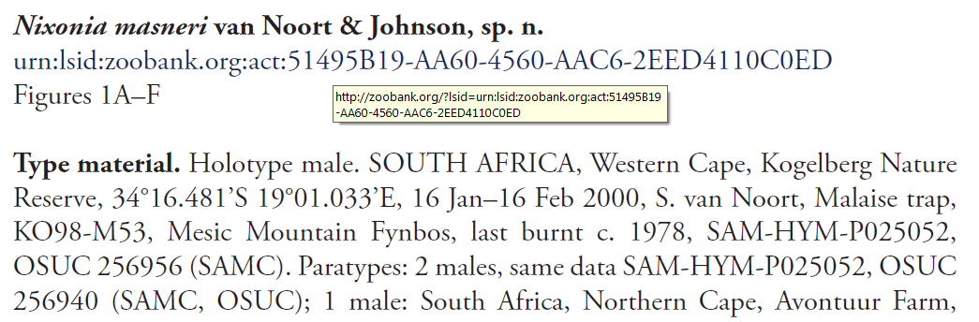
The PDF and the XML (eXtensible Markup Language)
<taxon-name-part taxon-name-part-type="genus">Nixonia</taxon-name-part>
  <taxon-name-part taxon-name-part-type="species">masneri</taxon-name-part>
  </taxon-name>
  - <taxon-author>
  <string-name>van Noort & Johnson</string-name>
  </taxon-author>
  <taxon-status>sp. n.</taxon-status>
  <xref>Figures 1A-F</xref>

Slide 4
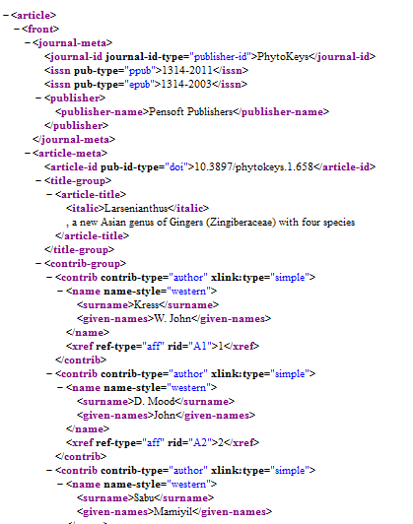

Why XML is so important?
Plazi

Slide 5
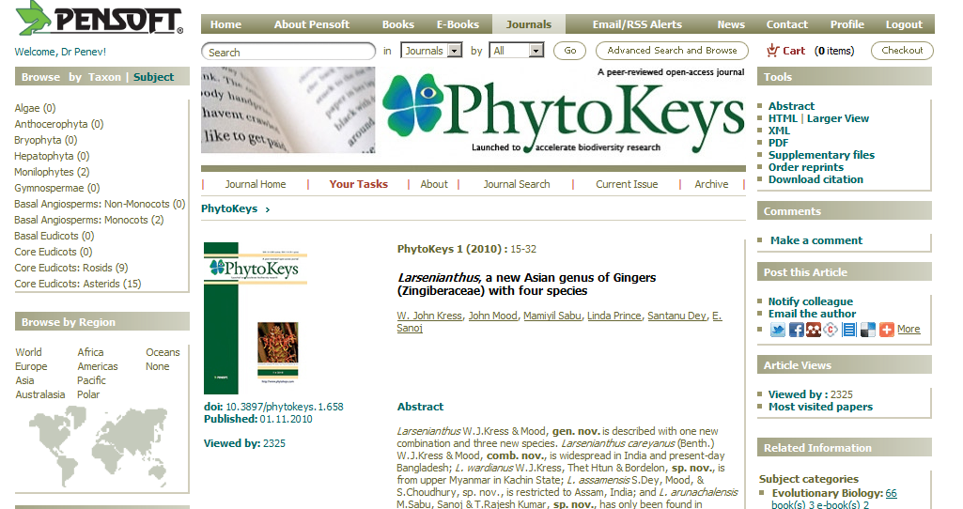
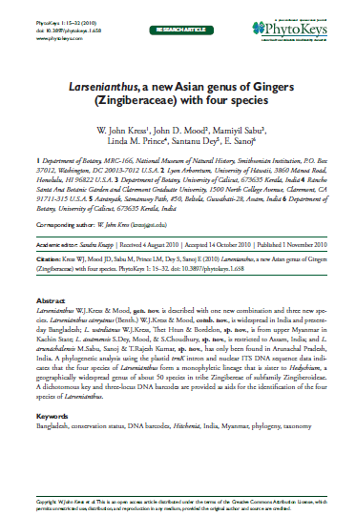
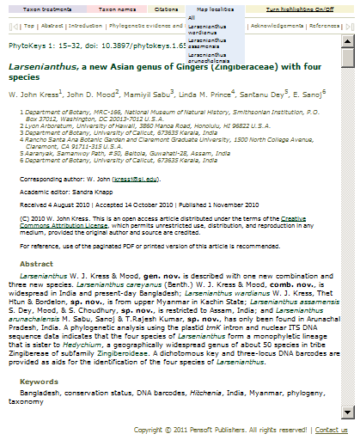
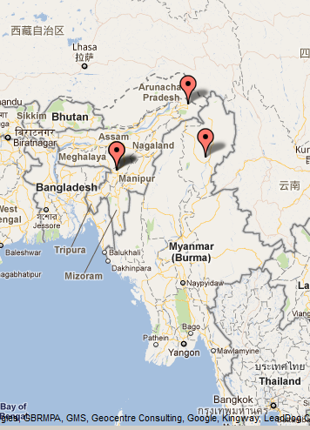
This is why we have more than one e-versions of the same paper

Slide 6
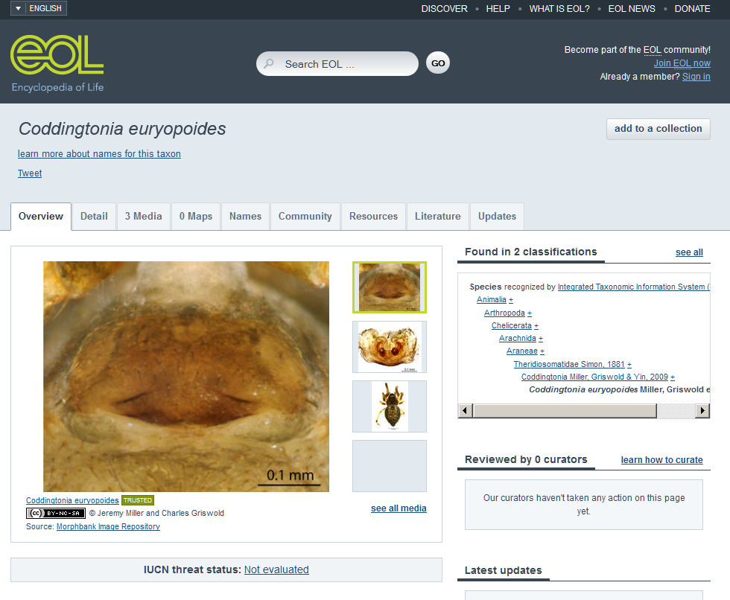
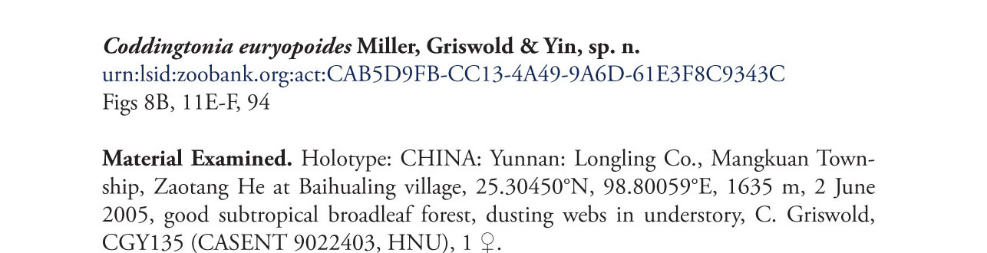
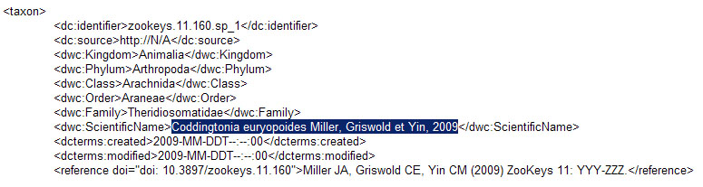
Species descriptions on Encyclopedia of Life (EOL)
XML
MARK UP

Slide 7
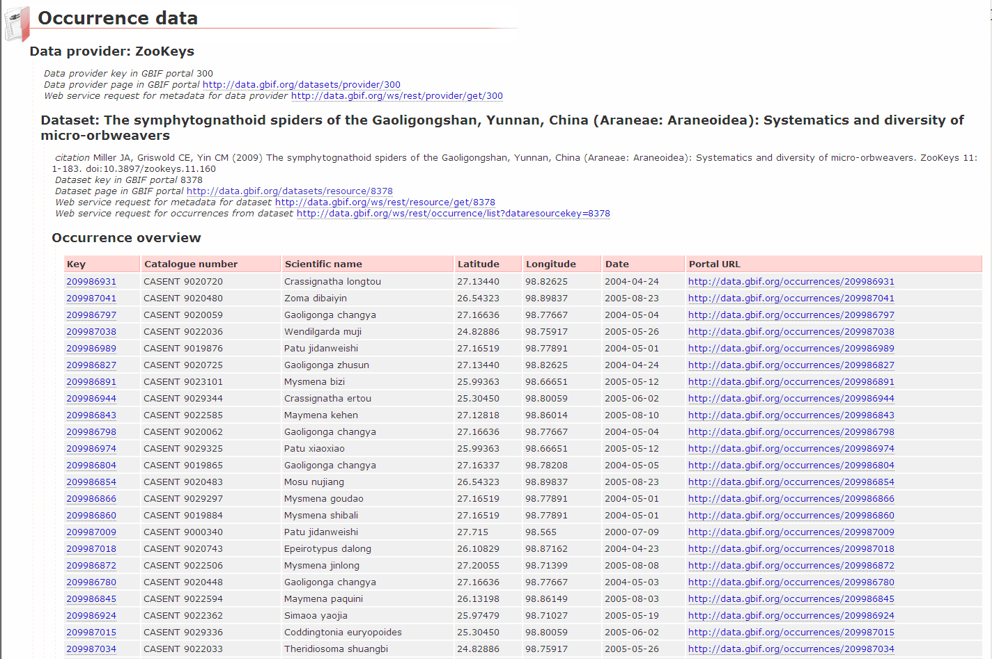
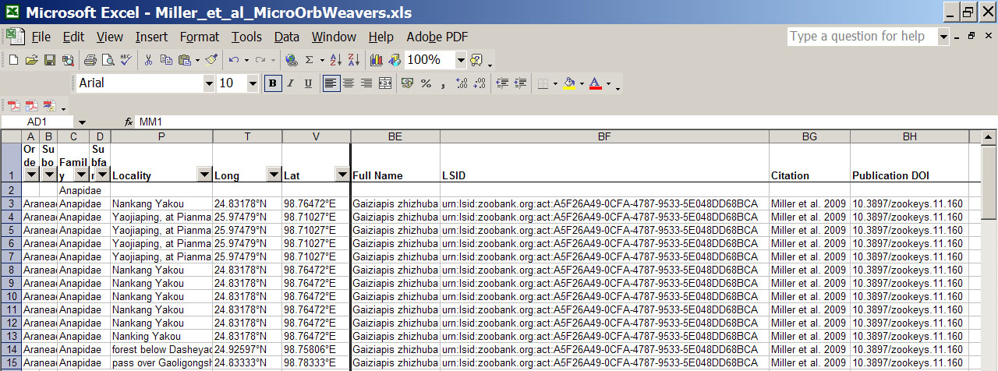
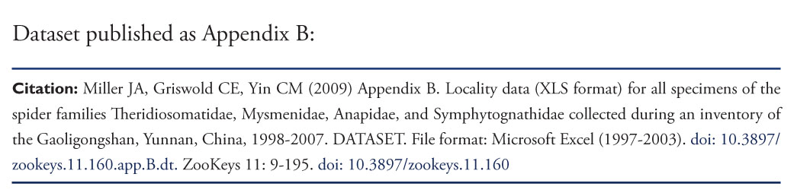
The occurrence dataset in GBIF
IPT

Slide 8
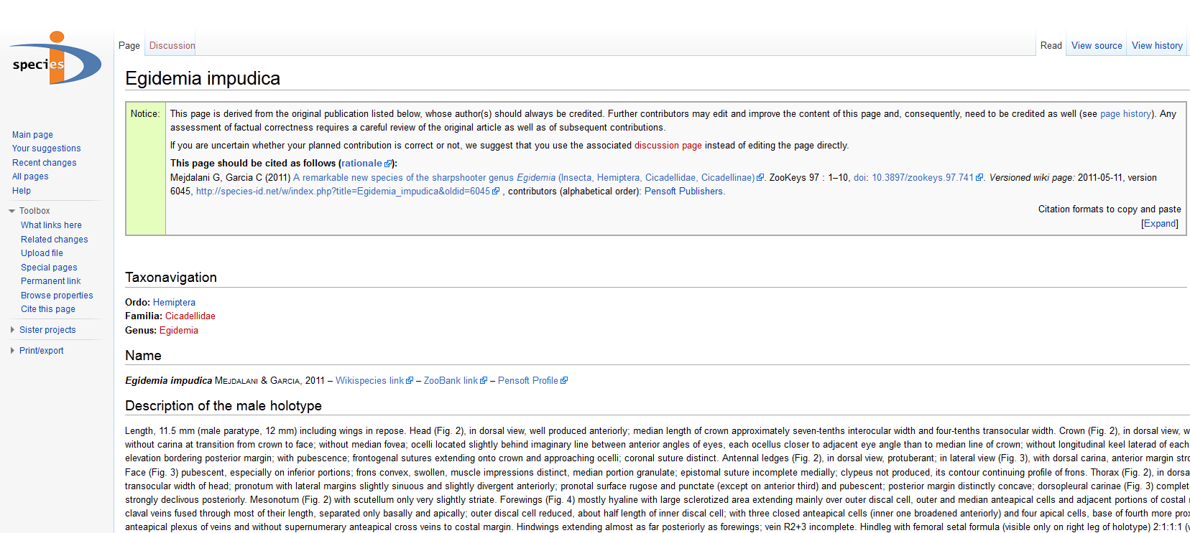
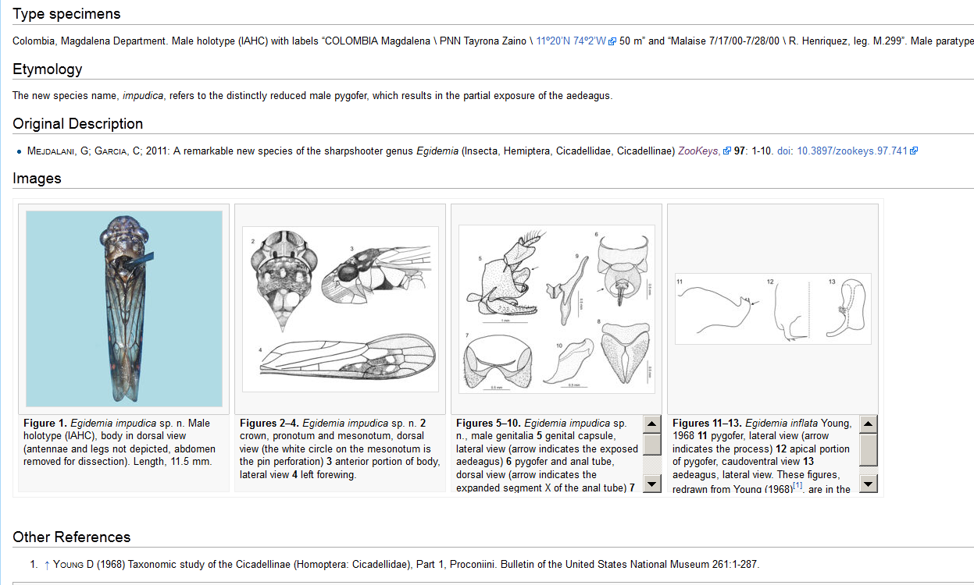
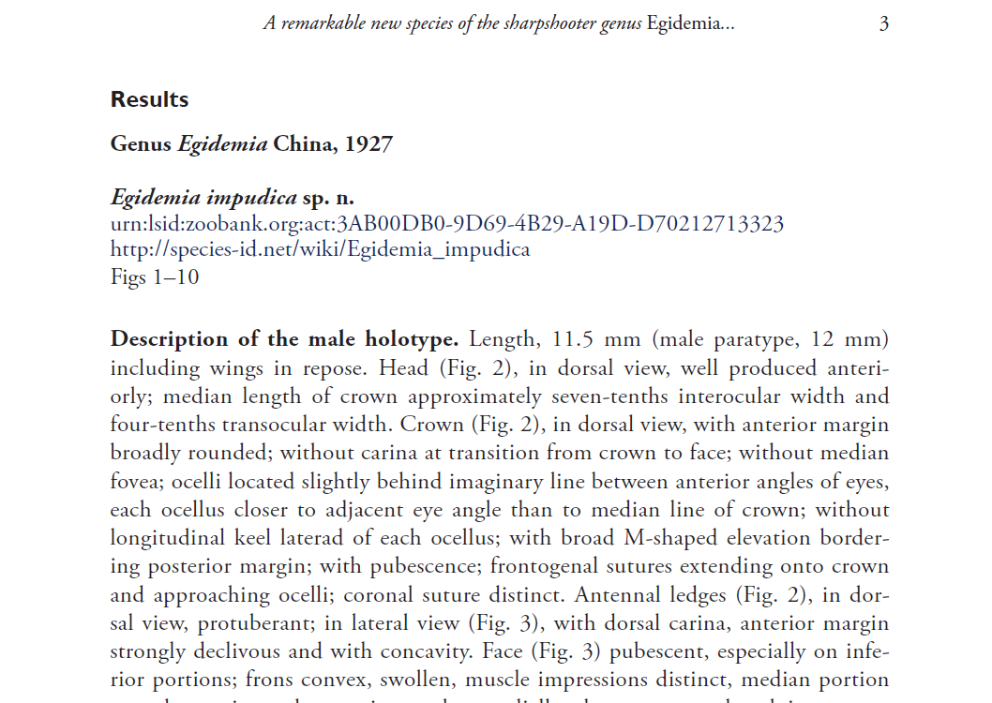
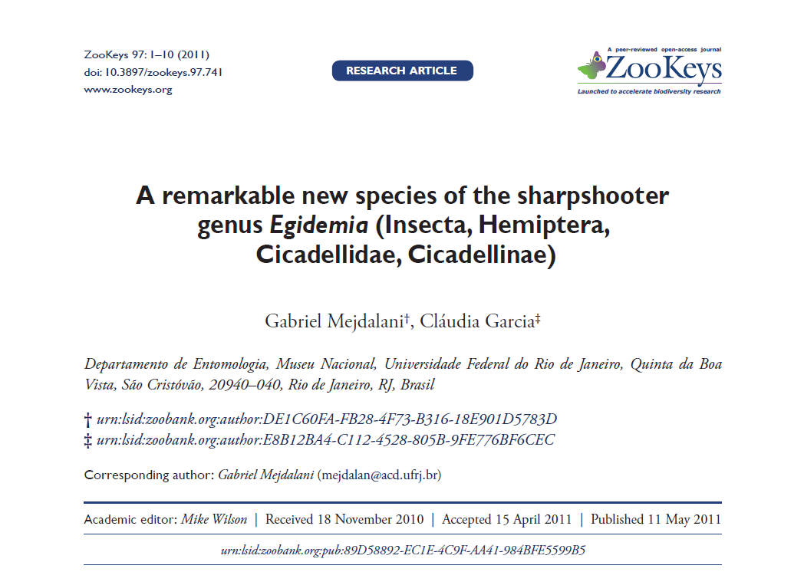
Simultaneous journal-Wiki publication

Slide 9
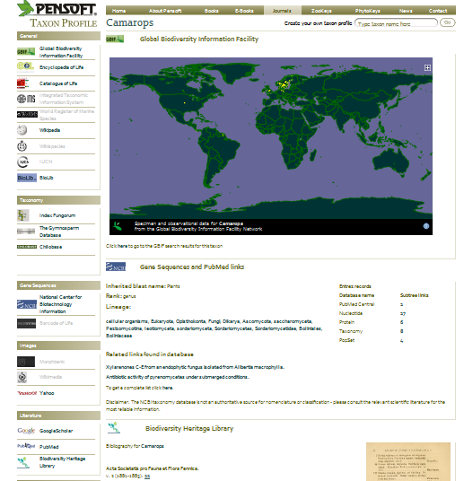

Slide 10
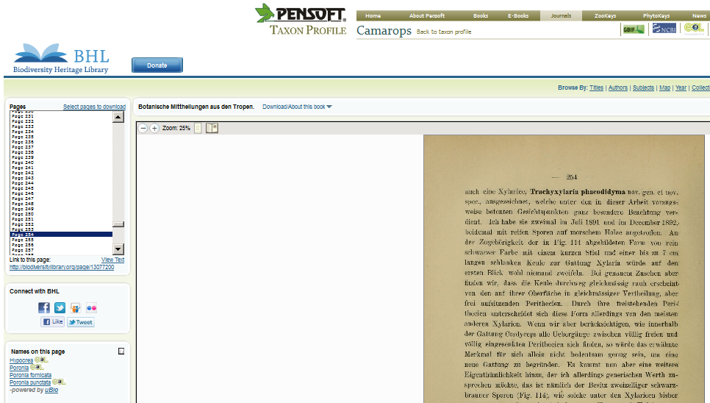

Slide 11
Pensoft Journal System
PJS 1.0 ⇒ 2.0

Slide 12
What is that?

Slide 13
PJS 2.0 is an online platform for:
    Authoring via Pensoft Writing Tool (PWT)
    Peer-review
    Editing
    Publishing
    Dissemination
    of scientific papers

Slide 14
Reviewers types in pjs 2.0

Slide 15
Nominated reviewers
Receives a formal request (cancelled if not responded to with N days)
Expected to submit a thorough review
Can edit and comment online
Has an individual due-date
Reminded via email if late

Slide 16
Panel reviewers
Receive a notification (NO obligation is taken up or implied)
Encouraged to submit a review
Can comment
Have a common due-date
Can’t work on manuscript after due-date
Not reminded via email

Slide 17
Review processes in PJS 2.0
Non-peer review
Notes:
Manuscripts are approved for publication based on editor’s decision. Used for editorials, correspondence, and corrigenda.

Slide 18
Review processes in PJS 2.0
Non-peer review
Closed peer-review
Notes:
Conventional peer-review that you are familiar with. Decision is still taken by the editor, but with feedback from reviewers.

Slide 19
Review processes in PJS 2.0
Community peer-review
Non-peer review
Closed peer-review
Notes:
Commmunity peer-review - the manuscript is visible only to the editor, reviewers and authors.

Slide 20
Review processes in PJS 2.0
Public peer-review
Community peer-review
Non-peer review
Closed peer-review
Notes:
The manuscript is visible and available for comments to all registered users of the journal.

Slide 21
Feedback
Public + PR + NR SE
Panel Reviewers + NR SE
Subject Editor
Nominated Reviewers SE

Slide 22
Markup ?
Upfront OR In-House markup ?
We have both of them!
    PJS 1.0 + PMT
    PWT + PJS 2.0
The journal decides which one to offer
Then the authors choose

Slide 23
What formats does PJS 2.0 use?
XML in
XML out
XML throughout
The humans never see it!
They read the web page
or download the PDF

Slide 24
Just to make this very clear
Author DO NOT DO markup in PWT!
They just write their manuscripts
The PWT DOES the markup for them

Slide 25
Benefits for authors
All versions of the manuscript stored online
Faster, better peer-reviews
Can suggest reviewers
No software to install, totally web based
Article parts are marked-up, not trapped in a monolithic publication.
Article parts are stored in appropriate worldwide databases

Slide 26
Benefits for reviewers
Easy on-line editing
Credit for reviews – option to publish the review alongside the article
Simplified interface, no nonsense dashboard, clear due dates
Email reminders

Slide 27
Benefits for journals
Per journal settings for
    manuscript types
    review process types
    due dates
    file-based or/and web-based workflow
United user (authors, reviewers, editors) base across the different journals. Journals benefit from each other.
Frequently Asked Questions by society journals that want to move to advanced open access publishing
http://www.pensoft.net/FAQ-by-society-journals

Slide 28
Document flow
Reviewer 1
versionn
Reviewer 1
versionn
edit
copy
Author’s
versionn
merge
Subject Editor
versionn
Merged
Vversionn
Decision,
revisions
Accept/Reject
changes, edit
merge
Reviewer 2
versionn
Reviewer 2
Vversionn
copy
edit

Slide 29

I Open Access!

Slide 30
And…

Slide 31
ViBRANT

Slide 32
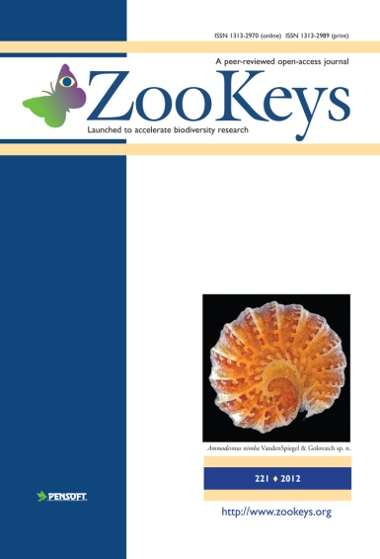
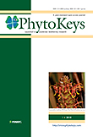
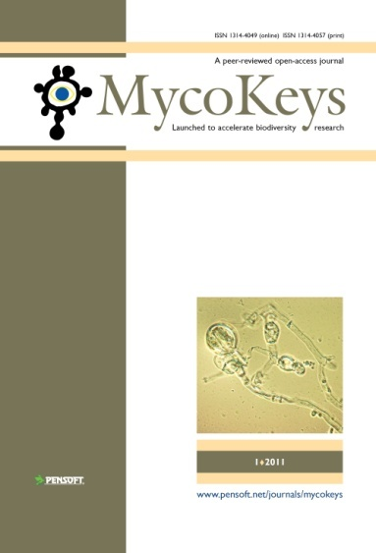
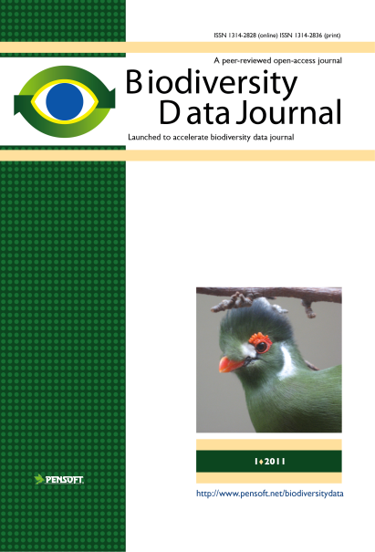
Thank you for your attention, and welcome to

Slide 33
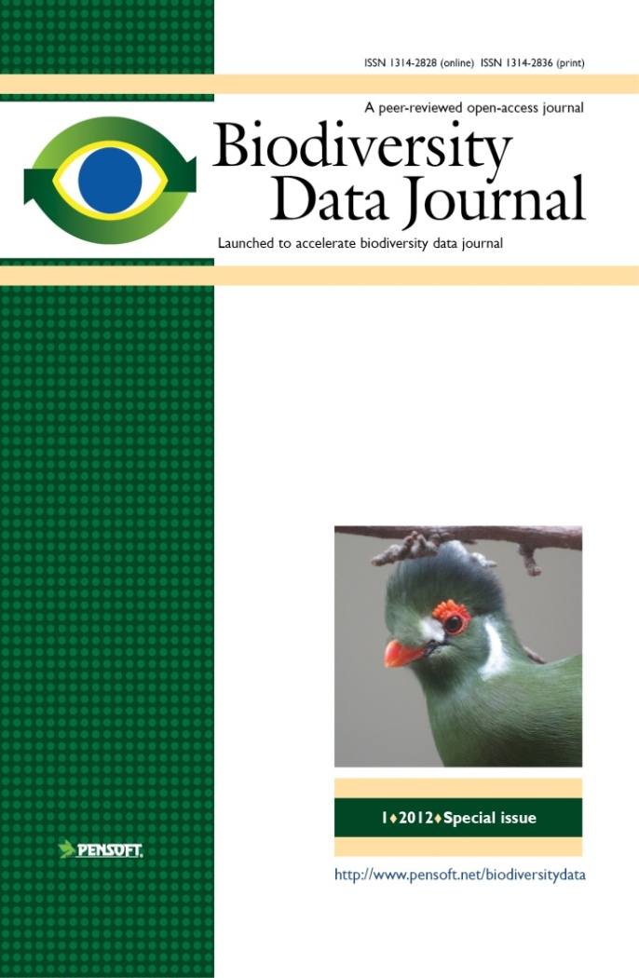
Key features
Collaborative article authoring
Online peer-review and editing
Community peer review; options for “open” and “public” review
Standard-compliant (DwC, NLM DTD)
Biological Codes compliant article templates
No lower/upper limit of manuscript size
Semantically enhanced “articles
of the future”
Integrated with GBIF, EOL, Dryad Scratchpads, etc.
ALL DATA MATTERS!

Slide 34






Workflow
Collaborative
ARTICLE AUTHORING
(PENSOFT WRITING
TOOL)
XML submission
Community peer-review
(options for public and
Open review)
ALL ONLINE!
Revisions
online
Authors, Reviewers, Editors, Mentors, Copyeditors
MANUSCRIPT published
XML text + data
ARTICLES
Biblio-
graphies
Occurr-
ence data
Taxon treatments
Taxon names
Plazi
Wiki
COL

Slide 35
Automated submission
Automated XML submission
Notes:
35
Slide 12: Next generation article publishing
Arguably our most ambitious developments in the context of scholarly communication concern the semi-automated construction of scholarly papers from databases. In many cases Scratchpads contain extensive data relating to the biology and description of particular species. These are highly suited to formal specialist publications, but doing so require the laborious assembly of these data into a manuscript. As part of the ViBRANT collaboration with Pensoft, and in particular their two journals specialising in the formal taxonomic descriptions of plants and animals, we have developed a 5-step workflow for users to selecting appropriate data from their Scratchpad, adding additional metadata describing this information so that it conforms with the norms of descriptive taxonomic publications, and then finally preview and submit this manuscript to the publisher. From here is goes through a standard peer review process. Review recommendations are then incorporated in to a revised version of the manuscript, which is then sent back to the publisher and simultaneously published on both the Scratchpad and in the publisher’s journal.
In addition to dramatically speeding up the construction of scientific papers, the user has the advantage that firstly the manuscript can be revised and updated and new information comes to light on the Scratchpad, while preserving the original version of the manuscript as part of the scholarly record. In addition the publish extracts relevant information from the submitted database which is them automatically submitted to the specialist data repositories.
So in sum then, these are the four ways in which ViBRANT is facilitation scholarly communication of biodiversity information. 1) Through low cost journal infrastructure; 2) by community web publishing; 3) by biodiversity observation data publishing; and 4) by next generation publishing services producing scholarly articles from databases.

